Slide 1
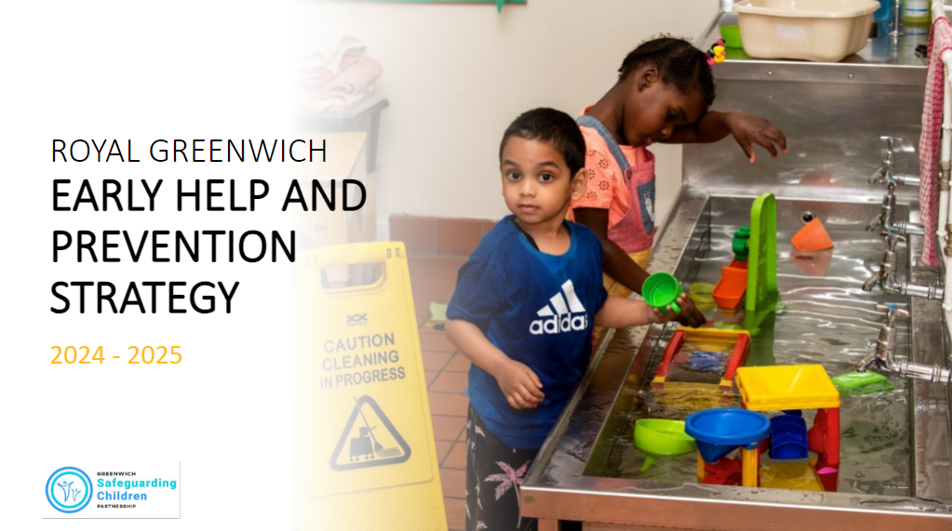
Early Help and Prevention Strategy
2024-2025
G-Hive Networking Event – Thursday 12 September 2024 a Content
Slide 1: What do we mean by early help and prevention?
Slide 2: Missions 2024-25
Slide 3: Building relationships across the early help and prevention system that works for all children
Slide 4: Safeguarding and prevention in schools
Slide 5: Exercise
Slide 6: Next steps
Slide 7: Thank you!

Slide 2
What do we mean by Early Help and Prevention?
Robust early intervention that creates safety, sustainability, and risk reduction.
Targeted support to stop problems from escalating.
Empowering communities to solve problems early.
The identification of risk factors and the provision of support at the earliest stages, with the aim of preventing problems occurring or escalating and breaking the cycle of targeted and acute intervention.
Key to this is empowering children, young people and families with the tools and resources they need to achieve sustained positive outcomes.
Type of prevention activity

Slide 3
Our missions 2024-25
Building relationships across the early help and prevention system that works for all children Working with our partners to understand our early help and current system and move towards and integrated prevention system in Greenwich | Effectiveness and impact of our early help and prevention services Improving our understanding of the effectiveness of the response of our universal services and lived experience of children, young people and families. | Safeguarding and prevention in schools Strengthening partnership approaches to better enable schools to provide timely support to children and young people at risk of poor outcomes
In developing this strategy, we have identified our immediate priorities for the next 12 to 18 months. In delivering our strategic priorities we will maintain a focus on the effectiveness of partnership approaches to strengthen and address adolescent safeguarding.
Adolescent Safeguarding

Slide 4
Strategic mission: Building relationships across the early help and prevention system that works for all children. Working with partners to understand our early help and current system and move towards and integrated prevention system in Greenwich
Our objectives 2024-25
Improve strategic oversight of EH & Prevention in the borough
Strengthen community engagement to understand the local picture and inform strategic planning - including a focus on adolescent safeguarding
Strengthen ‘holistic’ and place-based approaches to supporting our children, young people and families
Improve understanding of early help and prevention workforce and implement workforce development plan to assure the quality of whole family working.
Strengthen influence of family voice and experience in strategic planning
Deliver the ambitions of Family Hubs Programme

Slide 5
Our objective 2024-25
Continue to strengthen the interface between schools and social care in supporting vulnerable children and young people – including adolescents at risk of exploitation.
Improve understanding and awareness of the impact of poor attendance and the importance of education to strengthen professional curiosity and partnership working and improve outcomes for vulnerable learners.
Strengthen partnership working (schools, social care, voluntary and community sector and health) in providing effective early intervention and prevention support.
Improved identification and support for young carers.
The roll-out of Wellbeing in Schools Hubs (WISH).
Strategic mission:
Safeguarding and prevention in schools Strengthening partnership approaches to better enable schools to provide timely support to children and young people at risk of poor outcomes

Slide 6
Exercise
Please separate into two groups with each group taking one of the missions.
You will have 10 minutes to answer the questions on the next slide.
After 10 minutes a representative from each group will feedback on two key points.
For the remaining 10 minutes we will use the key points to identify actions that will be incorporated into the Early Help and Prevention Strategy action plan.

Slide 7
Building relationships across the early help and prevention system that works for all children.
In what ways do you think cross-sector collaboration (e.g., between the local authority and VCS) can be improved to better serve children and families?
How can we facilitate better sharing of resources, knowledge, and expertise to ensure a more integrated and effective early help and prevention system?
What mechanisms are in place for receiving feedback from children, families, and other stakeholders? How do you use this feedback to improve your services and the overall system?

Slide 8
Safeguarding and prevention in schools.
How well do you believe community organisations (including your own) are aware of early help and prevention support for children, young people and families?
What strategies do you suggest for improving the early identification of risks to children, particularly those related to exploitation and poor attendance?
What feedback mechanisms can you suggest to facilitate better sharing of local intelligence?

Slide 9
Next steps
Disseminate Session Outcomes:
Embed suggestions into the strategy action plan
Report on progress
Circulate a summary of the key points discussed, including the
any action items identified during the event.
Incorporate the suggestions raised in the session into the wider
Early Help and Prevention Strategy action plan.
Report back to the network on the progress of the strategy at the
G-Hive event in December 2024.

Slide 10
THANK YOU!
If you would like to be involved further in this work, we would love to hear from you. Please reach out to one of us using the contact details below.
Jummy (Olajumoke) Hemsley, Head of Delivery and Improvement
Email: olajumoke.hemsley@royalgreenwich.gov.uk
Sherry Glasgow, Innovation and Improvement Team Leader
Email: sherry.glasgow@royalgreenwich.gov.uk
Tel: 020 8921 8906

Slide 11
References
Children’s Social Care: Stable Homes, Built on Love – Consultation Response (DfE, 2023) Children's Social Care: Stable Homes, Built on Love consultation response (publishing.service.gov.uk)
Working Together to Safeguard Children: a guide to multi-agency working to help, protect and promote the welfare of Children (Department for Education (DfE) 2023) Working together to safeguard children 2023: a guide to multi-agency working to help, protect and promote the welfare of children
Early help and early intervention. The National Society for the Prevention of Cruelty to Children (NSPCC) (updated 2023). https://learning.nspcc.org.uk/safeguarding-child-protection/early-help-and-early-intervention
Ten Years of Supporting Families: Supporting Families programme Annual Report 2022-23. (DfE, 2023). https://www.gov.uk/government/publications/ten-years-of-supporting-families-supporting-families-programme-annual-report-2022-23
Early Help System Guide. (DfE, 2023). https://www.gov.uk/government/publications/supporting-families-early-help-system-guide
What is early help? Concepts, policy directions and multi-agency perspectives. (Ofsted, 2022). https://socialcareinspection.blog.gov.uk/2022/02/10/reflecting-on-early-help/
The Independent Review of Children's Social Care: Final report. Independent Review of Children's Social Care (2022). Independent review of children's social care - final report (publishing.service.gov.uk)
The State of Early Help in England 2022. The Early Intervention Foundation (EIF) (2022). https://www.eif.org.uk/
Early help central to plans for 'radical reform' of children's social care in England. CYP Now (2021). https://earlyhelpconference.com/earlyhelp2023/en/page/home
Working Together to Improve School Attendance Guidance 2024. (DfE,2024) Working together to improve school attendance (applies from 19 August 2024) (publishing.service.gov.uk)

